Slide 1
Synchronous Sequential Circuits
Text book: Digital Design by Morris Mano,2nd edition, 6th Chapter

Slide 2
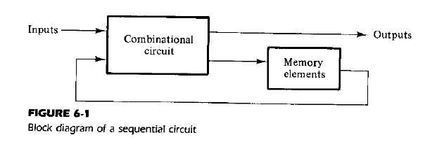
The digital circuits considered thus far have been combinational, i.e., the outputs at any instant of time are entirely dependent upon the inputs present at that time.
Although every digital system is likely to have combinational circuits, most systems encountered in practice also include memory elements, which require that the system be described in terms of sequential.

Slide 3
In the diagram, the memory elements are devices capable of storing binary information within them.
The binary information stored in the memory elements at any given time defines the state of the sequential circuit.
The sequential circuit receives binary information from external inputs. These inputs, together with the present state of the memory elements, determine the binary value at the output terminals.
They also determine the condition for changing the state in the memory elements.
The block diagram demonstrates that the external outputs in a sequential circuit are a function not only of external inputs, but also of the present state of the memory elements. The next state of the memory elements is also a function of external inputs and the present state.
Thus, a sequential circuit is specified by a time sequence of inputs, outputs, and internal states.

Slide 4
Two main types of sequential circuits. :
Synchronous sequential circuit
Asynchronous sequential circuit
A synchronous sequential circuit is a system Whose behavior can be defined from the knowledge of its signals at discrete instants of time. Synchronization is achieved by a timing device called a clock generator, which provides a clock signal having the form of a periodic train of clock pulses. The activity within the circuit and the resulting updating of stored values is synchronized to the occurrence of clock pulses.
The behavior of an asynchronous sequential circuit depends upon the order in which its input signals change and can be affected at any instant of time.

Slide 5
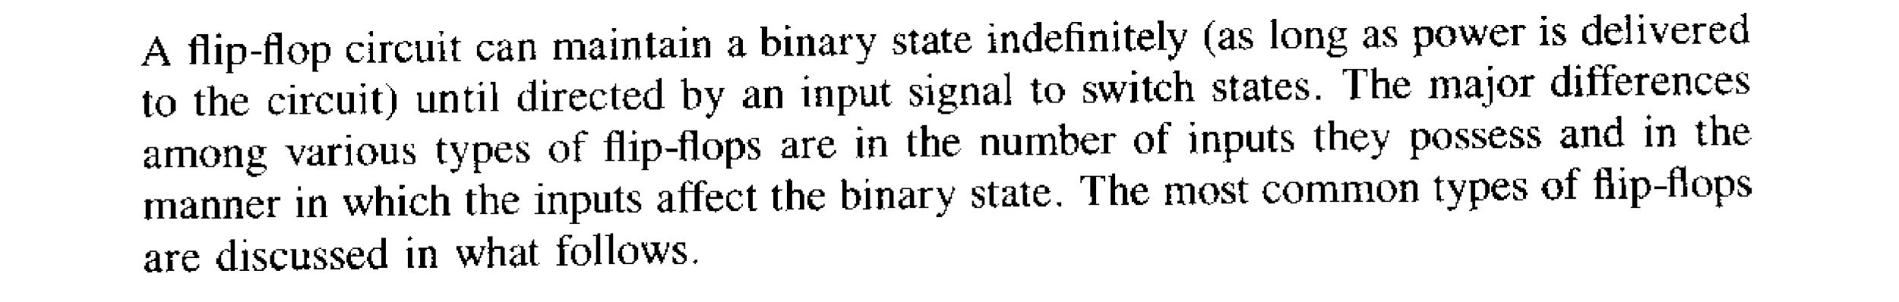
Flip Flop
A flip-flop is a binary storage device capable of storing one bit of information. In a stable state, the output of a flip-flop is either 0 or 1. A sequential circuit may use many flip-flops to store as many bits as necessary.

Slide 6
Basic Flip Flop Circuit
A FF circuit can be constructed from two cross-coupled NOR gates or two cross-coupled NAND gates, and two inputs labeled S for set and R for reset. Each FF has two outputs, Q and Q’ This type of FF is also called as SR latch.

Slide 7
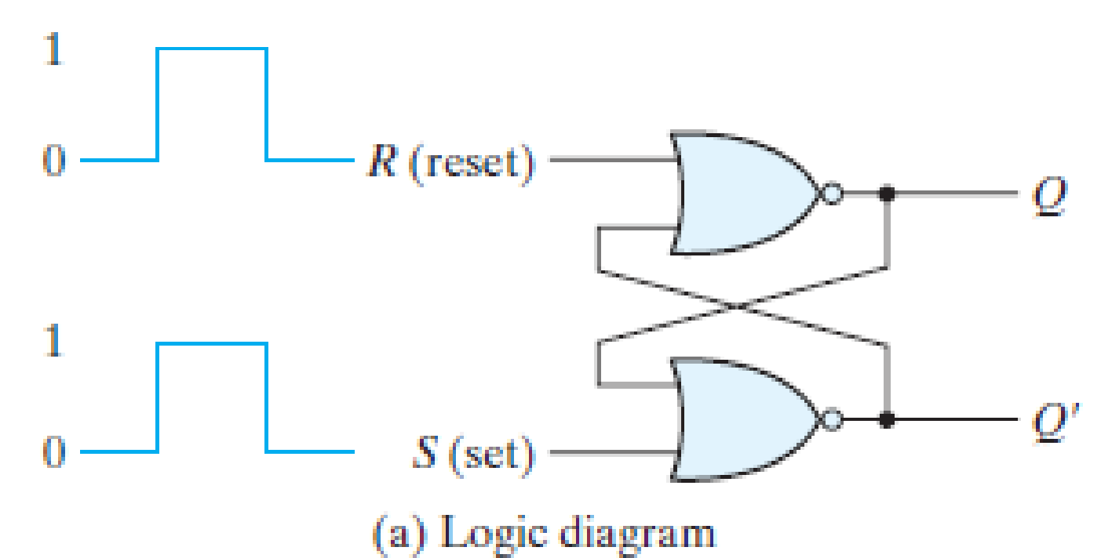
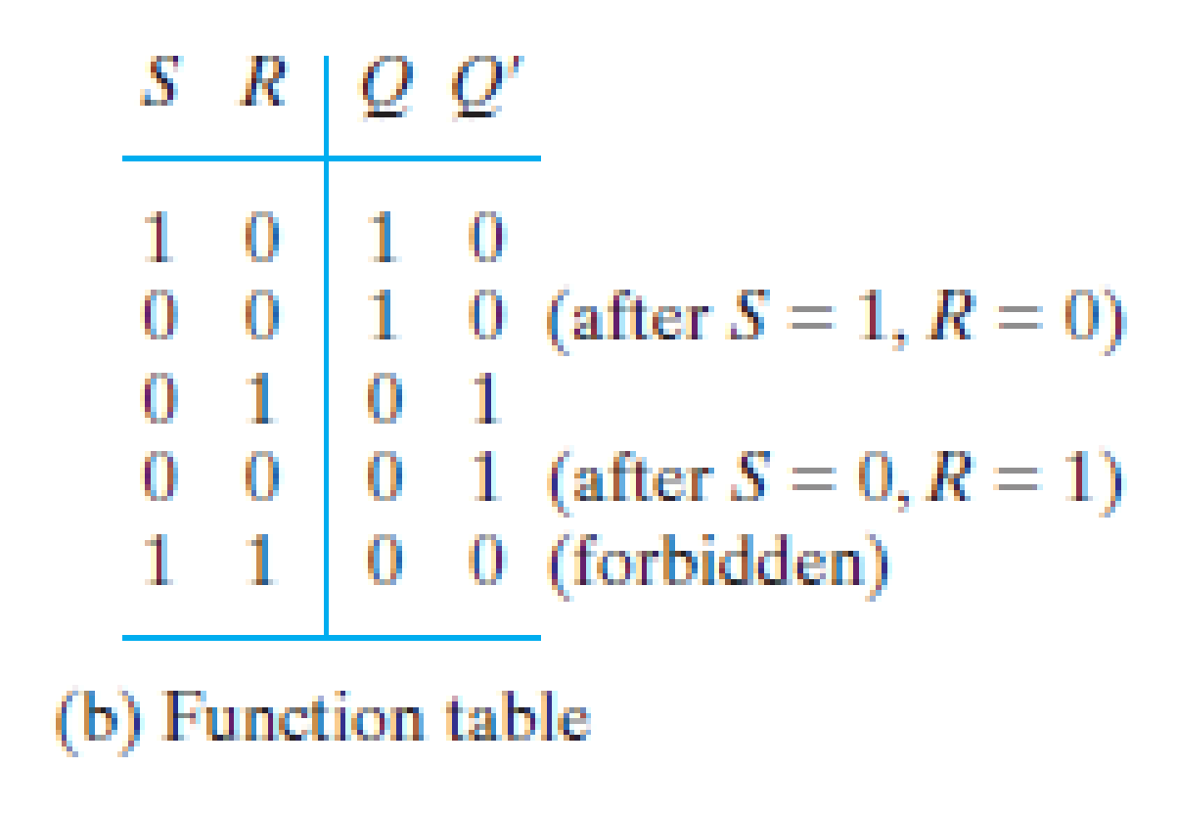
Basic FF circuit with NOR gates
The output of a NOR gate is 0 if any input is 1, and that the output is 1 only when all the inputs are 0.

Slide 8
It has two useful states. When output Q = 1 and Q’ = 0, it is said to be in the set state. When Q = 0 and Q’ = 1, it is in the reset state.
Outputs Q and Q’ are normally the complement of each other. The binary state of the FF is taken to be the value of the normal output.
When both inputs are equal to 1 at the same time, a condition in which both outputs are equal to 0 (rather than be mutually complementary) occurs. If both inputs are then switched to 0 simultaneously, the device will enter an unpredictable or undefined state or a metastable state. Consequently, in practical applications, setting both inputs to 1 is forbidden.

Slide 9
Under normal conditions, both inputs remain at 0 unless the state has to be changed. The application of a momentary 1 to the S input causes the FF to go to the set state. The S input must go back to 0 before any other changes take place, in order to avoid the occurrence of an undefined next state that results from the forbidden input condition.
When both inputs S and R are equal to 0, the FF can be in either the set or the reset state, depending on which input was most recently a 1.
If a 1 is applied to both the S and R inputs, both outputs go to 0. This action produces an undefined next state, because the state that results from the input transitions depends on the order in which they return to 0. It also violates the requirement that outputs be the complement of each other. In normal operation, this condition is avoided by making sure that 1’s are not applied to both inputs simultaneously.

Slide 10
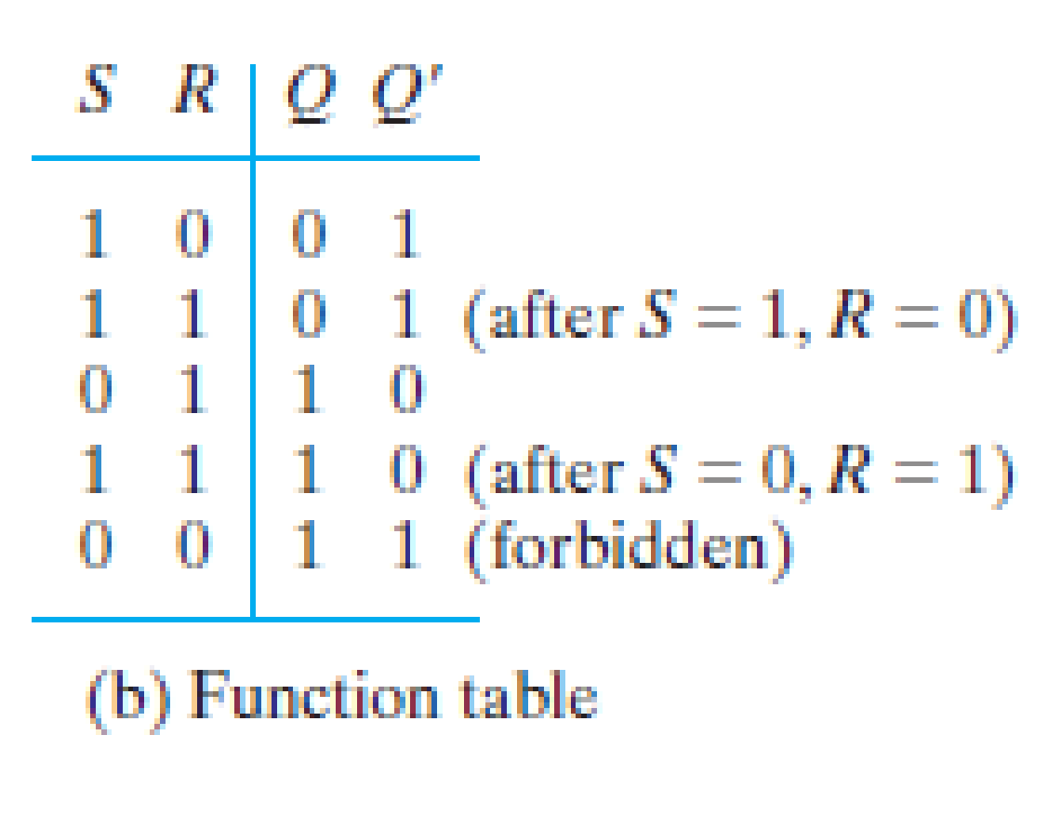
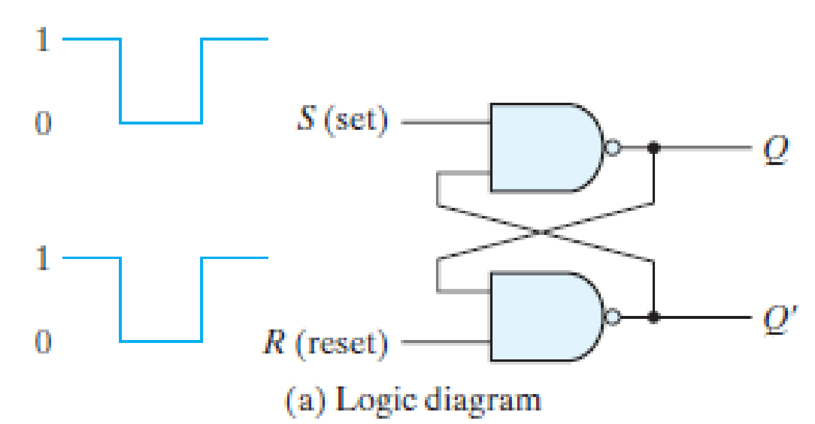
Basic FF circuit with NAND gates
The output of a NAND gate is 1 if any input is 0, and that the output is 0 only when all the inputs are 1.

Slide 11
It operates with both inputs normally at 1, unless the state has to be changed. The application of 0 to the S input causes output Q to go to 1, putting the FF in the set state.
When the S input goes back to 1, the circuit remains in the set state. After both inputs go back to 1, we are allowed to change the state of the FF by placing a 0 in the R input. This action causes the circuit to go to the reset state and stay there even after both inputs return to 1.
The condition that is forbidden for the NAND FF is both inputs being equal to 0 at the same time, an input combination that should be avoided.

Slide 12
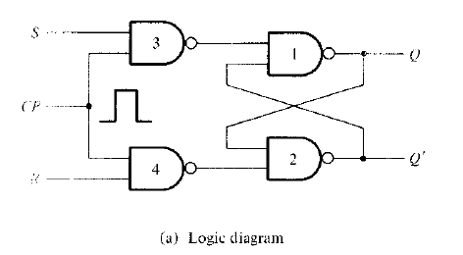
SR FF with NAND gates and Clock
FFs with clock signal are called clocked FFs or simply FFs

Slide 13
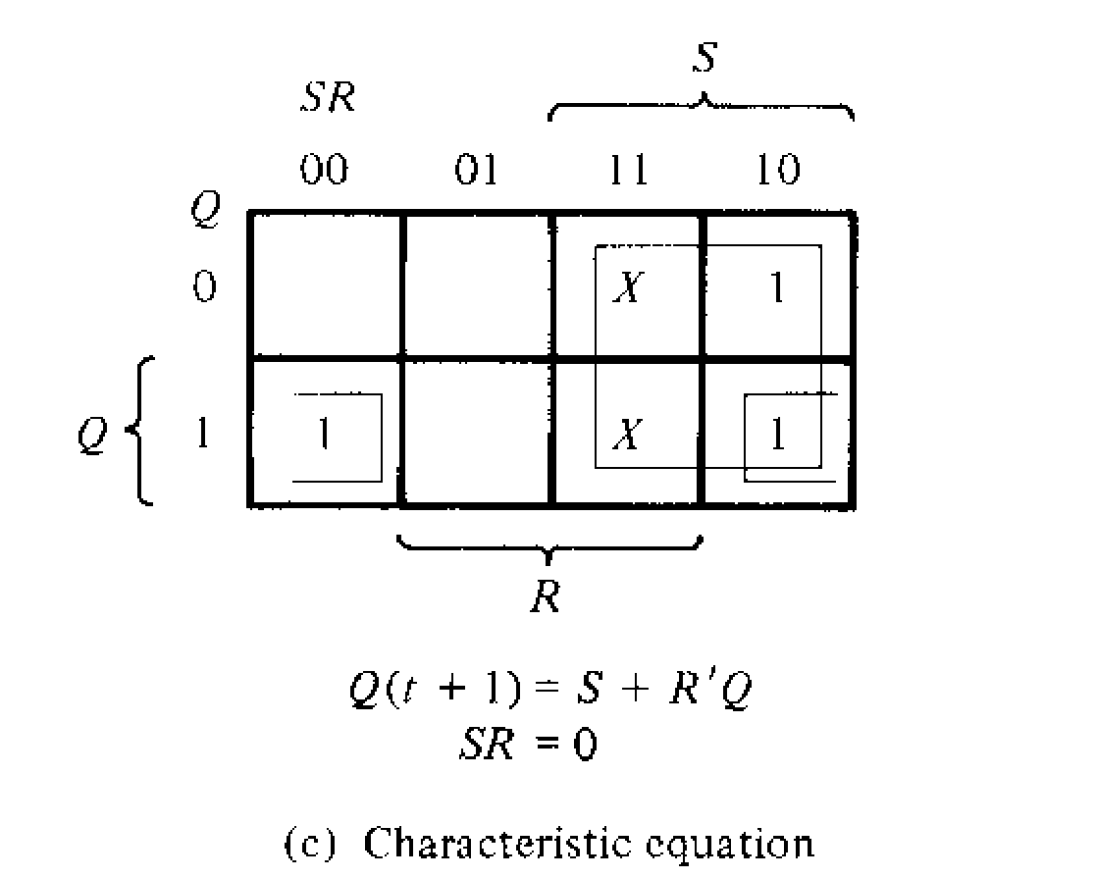
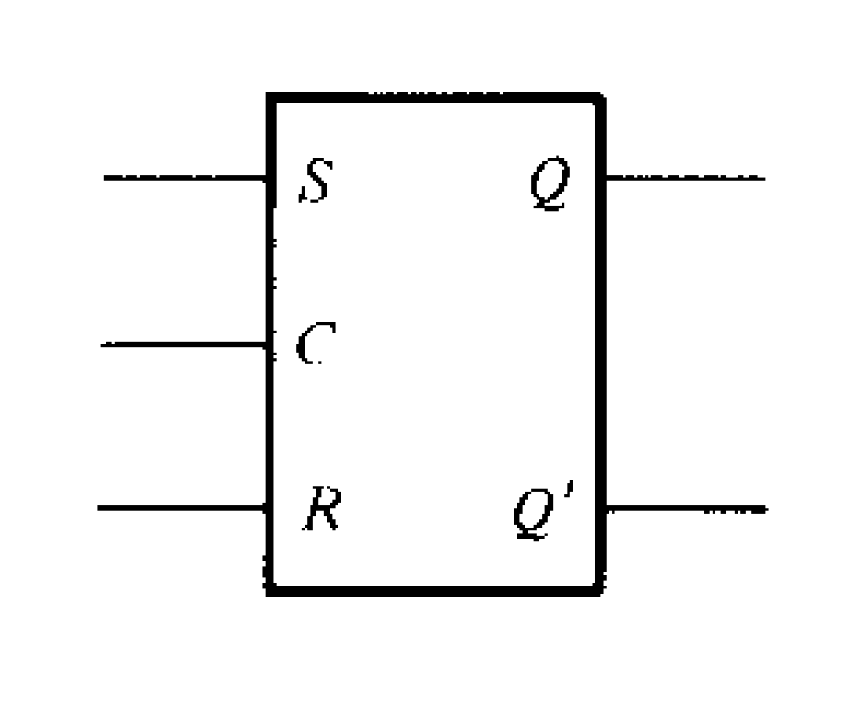
Q | S | R | Qt+1
0 | 0 | 0 | 0
0 | 0 | 1 | 0
0 | 1 | 0 | 1
0 | 1 | 1 | Indeterminate
1 | 0 | 0 | 1
1 | 0 | 1 | 0
1 | 1 | 0 | 1
1 | 1 | 1 | Indeterminate
b) Characteristic Table
c) Graphical Symbol

Slide 14
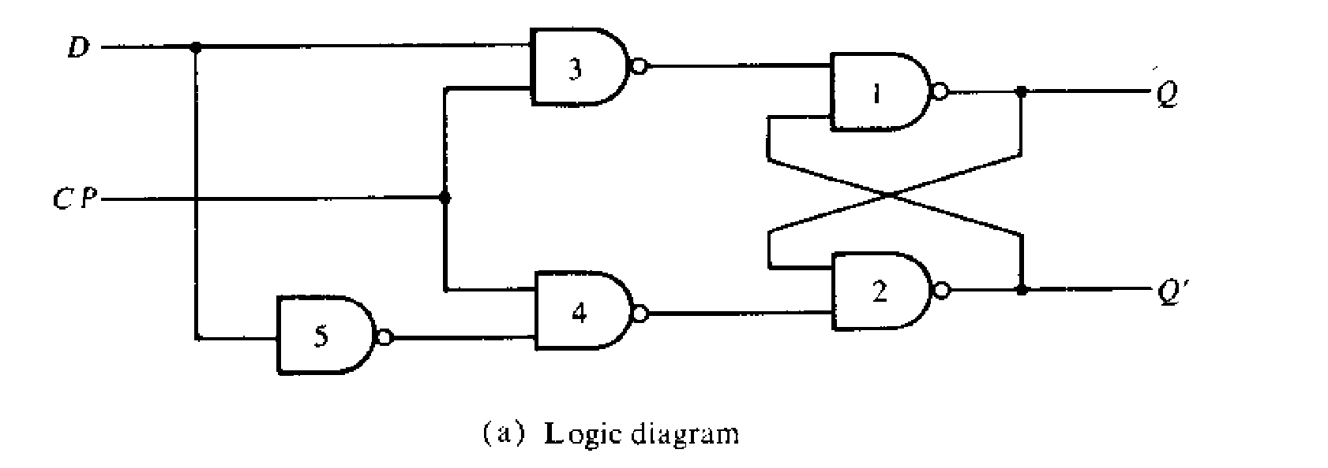
D Flip Flop

Slide 15
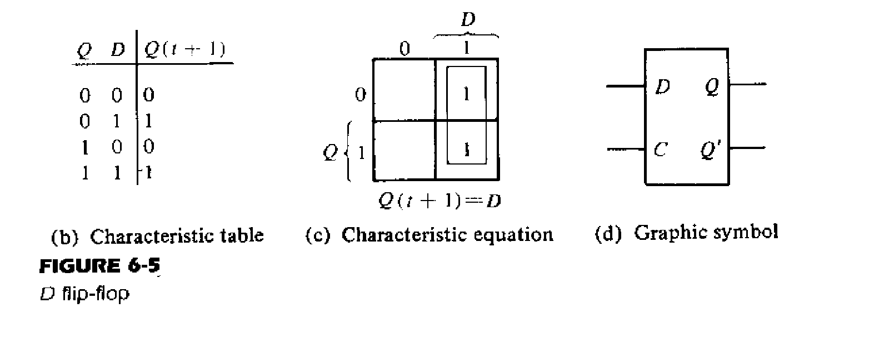

Slide 16
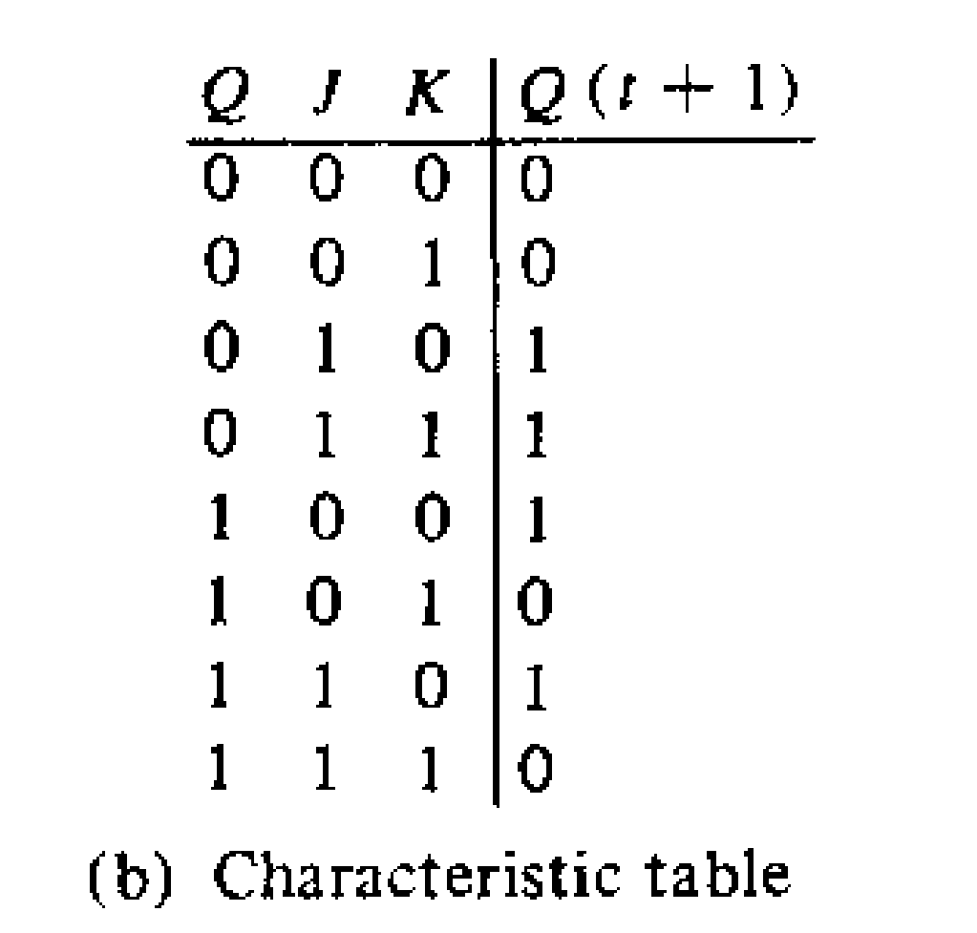
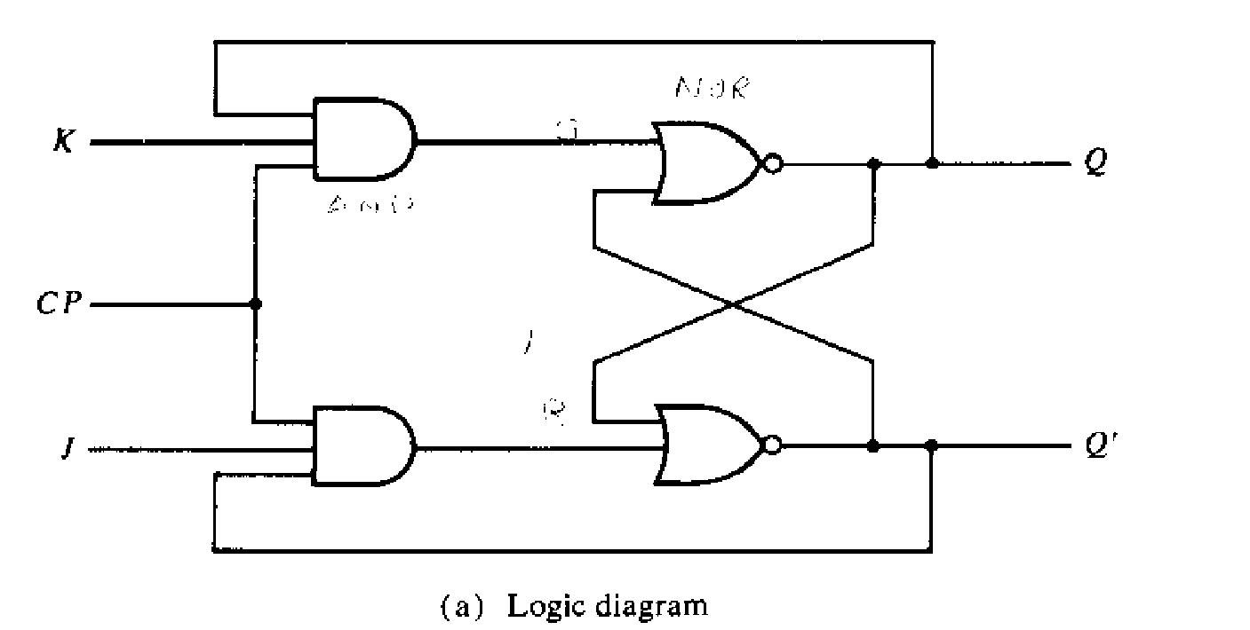
JK Flip flop

Slide 17
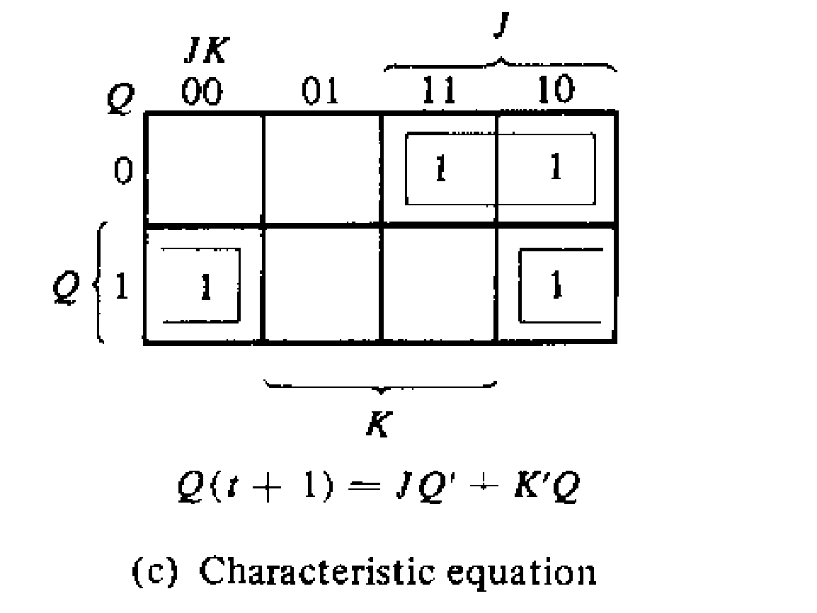

Slide 18
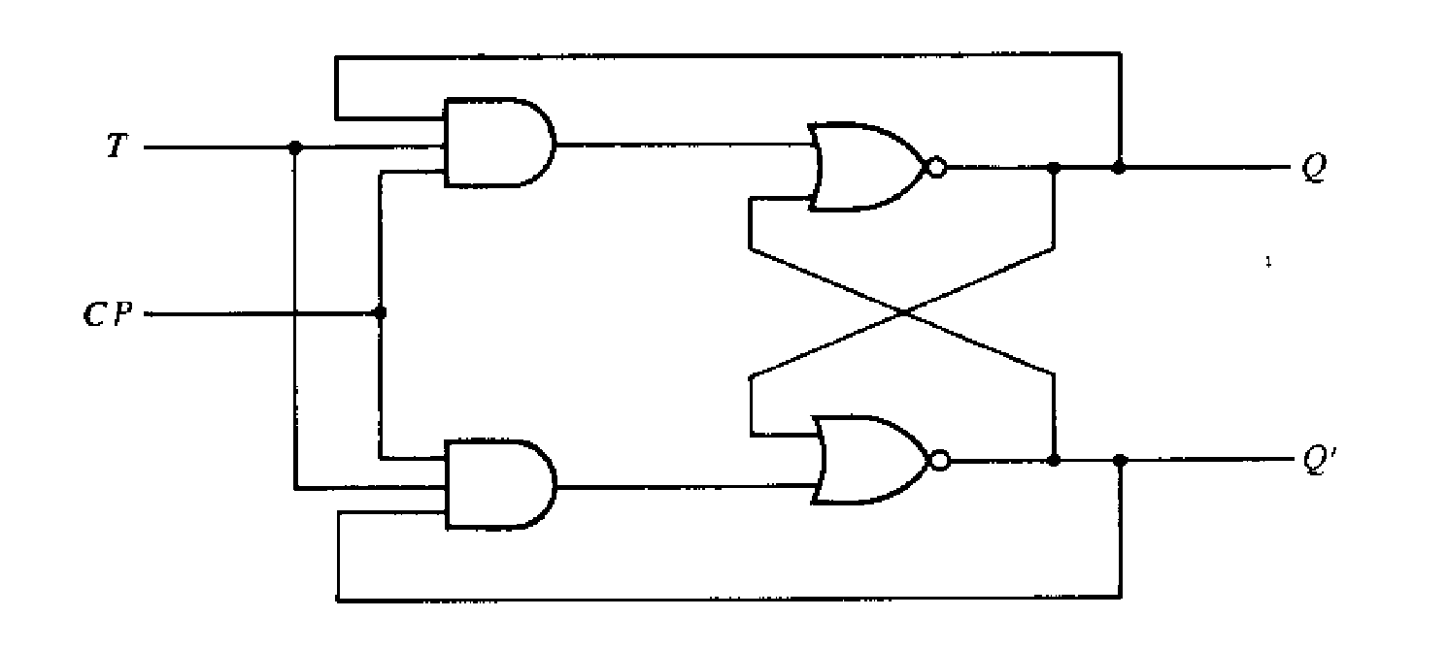
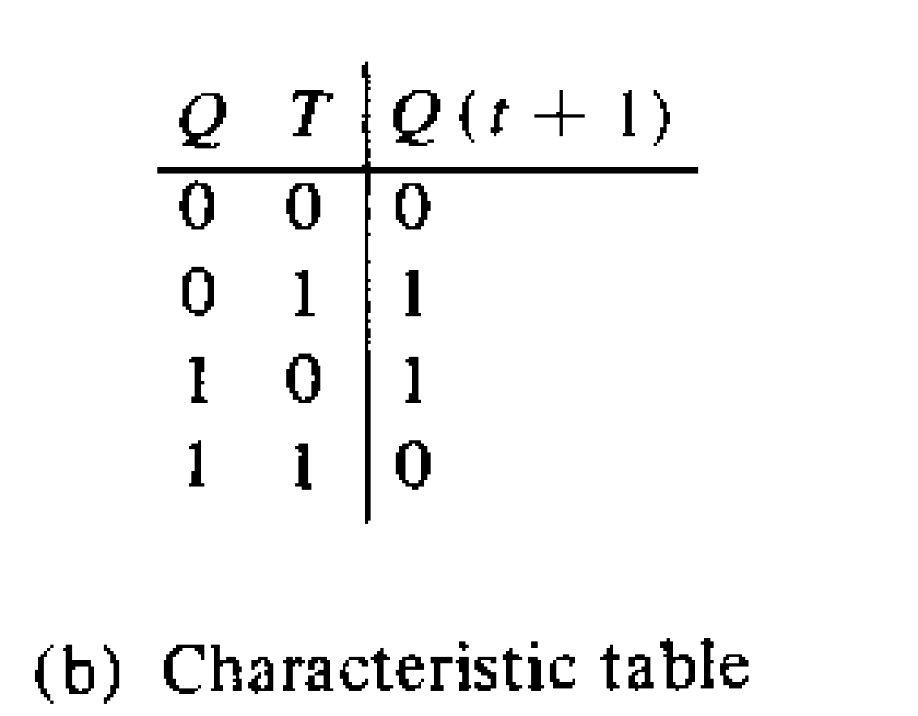
T Flip flop
T FF Logic Diagram

Slide 19
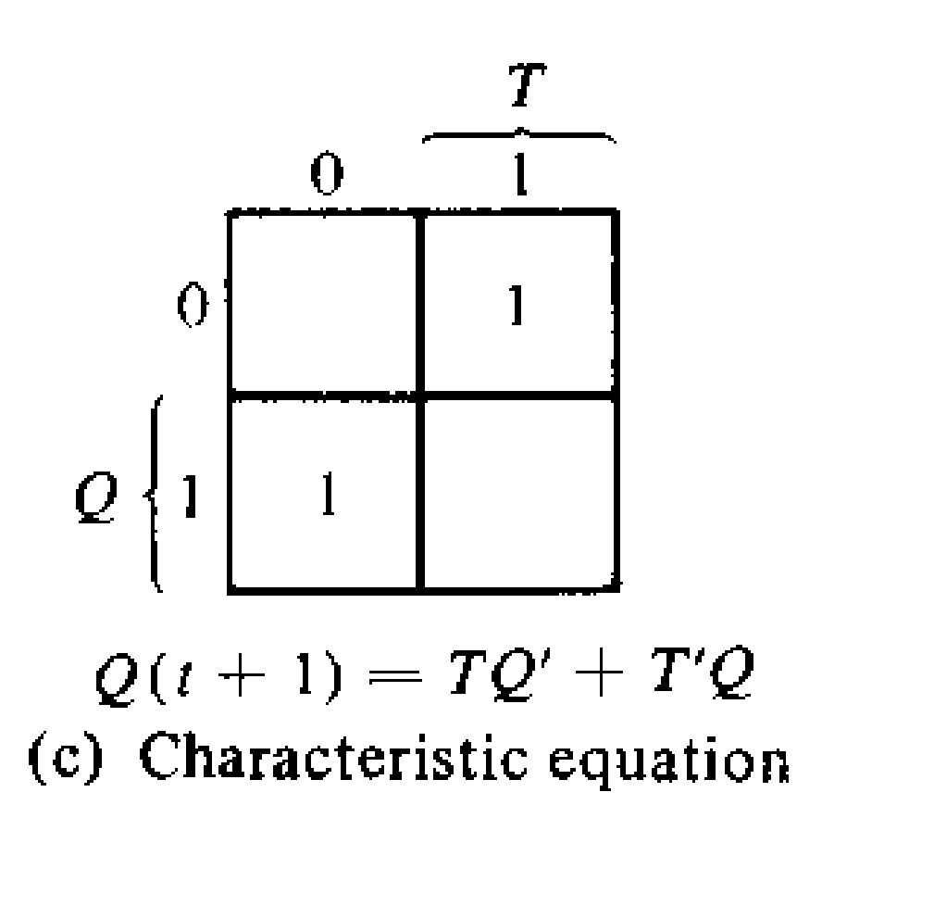

Slide 20
Triggering of flip flops
The state of a flipflop is switched by a momentary change in the input signal. This momentary change is called a trigger and the transition it causes is said to trigger the flipflop.
Clocked FFs are triggered by clock pulses
Clock is a signal that oscillates between a high and a low state

Slide 21
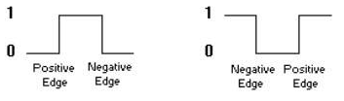
Positive pulse
Negative pulse
A positive clock source remains at 0 during the interval between pulses and goes to 1 during the occurrence of a pulse
The pulse transition from 0 to 1 is called positive edge and that from 1 to 0 is called negative edge.

Slide 22
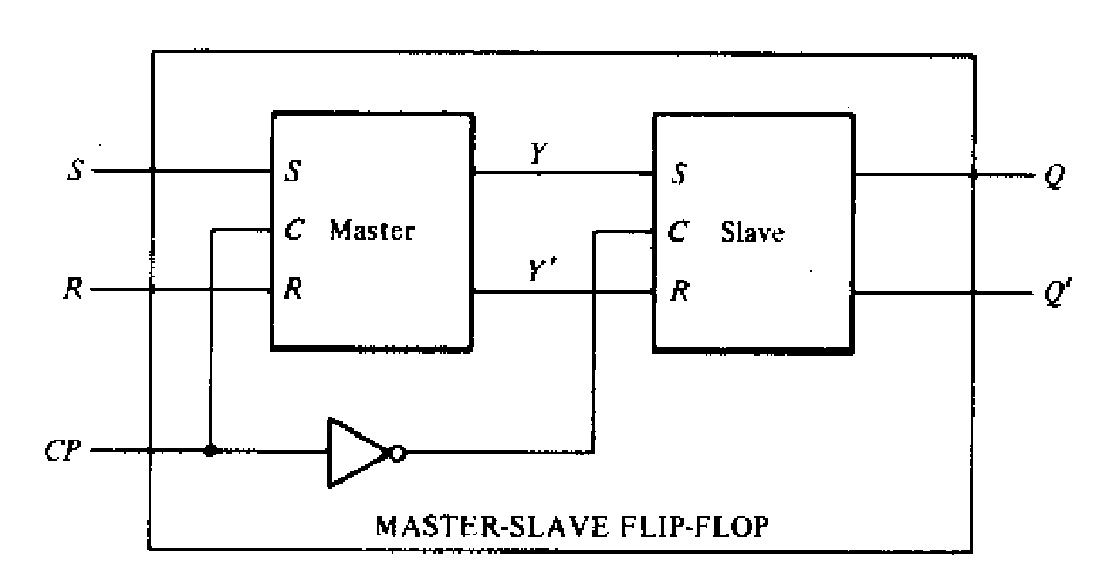
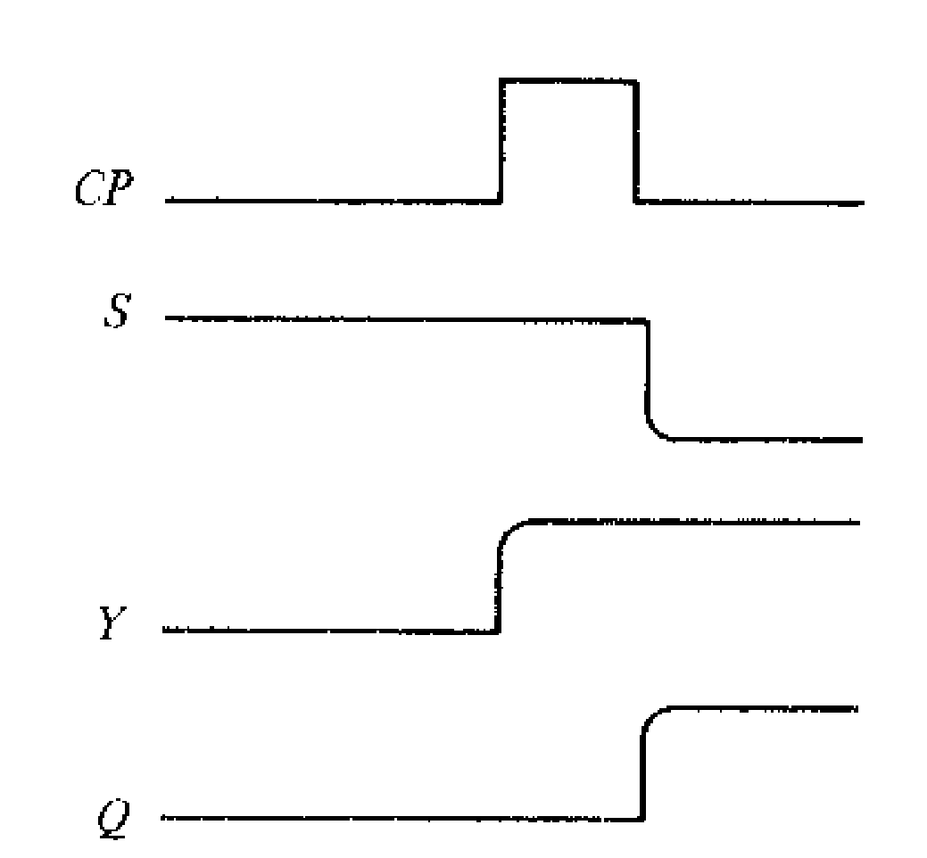
Master Slave FF

Slide 23
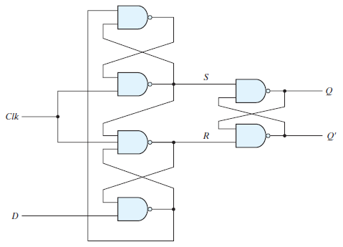
Edge Triggered FF

Slide 24
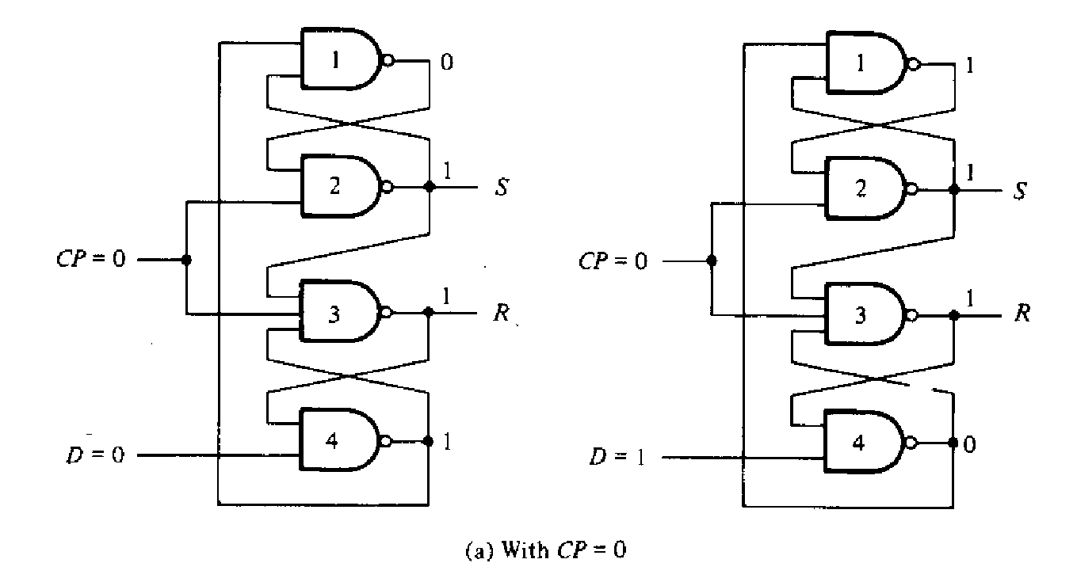

Slide 25
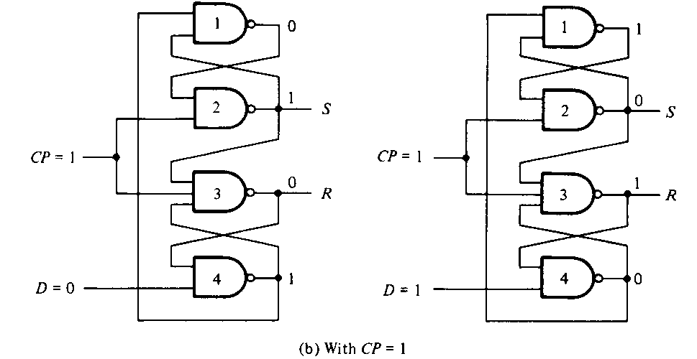
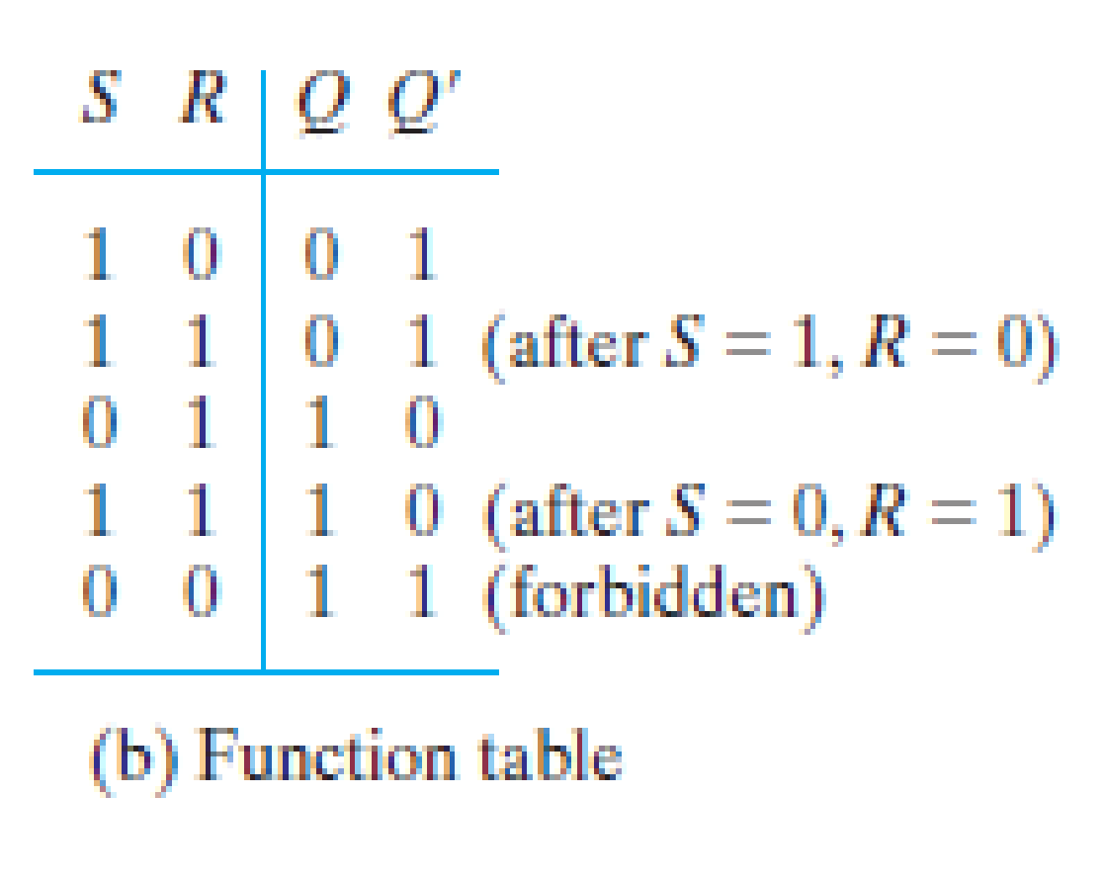

Slide 26
When the input clock in the positive-edge-triggered flip-flop makes a positive transition, the value of D is transferred to Q . A negative transition of the clock (i.e., from 1 to 0) does not affect the output, nor is the output affected by changes in D when Clock is in the steady logic-1 level or the logic-0 level. Hence, this type of flip-flop responds to the transition from 0 to 1 and nothing else.
There is a minimum time called the setup time during which the D input must be maintained at a constant value prior to the occurrence of the clock transition. It is equal to the propagation delay through the gates 4 and 1 since a change in D causes a change in the outputs of these two gates
Similarly, there is a minimum time called the hold time during which the D input must not change after the application of the positive transition of the clock. When D=0, it is the propagation delay of gate 3, since it must be ensured that R becomes 0 in order to maintain the output of gate 4 at 1, regardless the value of D. When D=1, it is the propagation delay of gate 2, since it must be ensured that S becomes 0 in order to maintain the output of gate 1 at 1, regardless the value of D
The propagation delay time of the flip-flop is defined as the interval between the trigger edge and the stabilization of the output to a new state

Slide 27
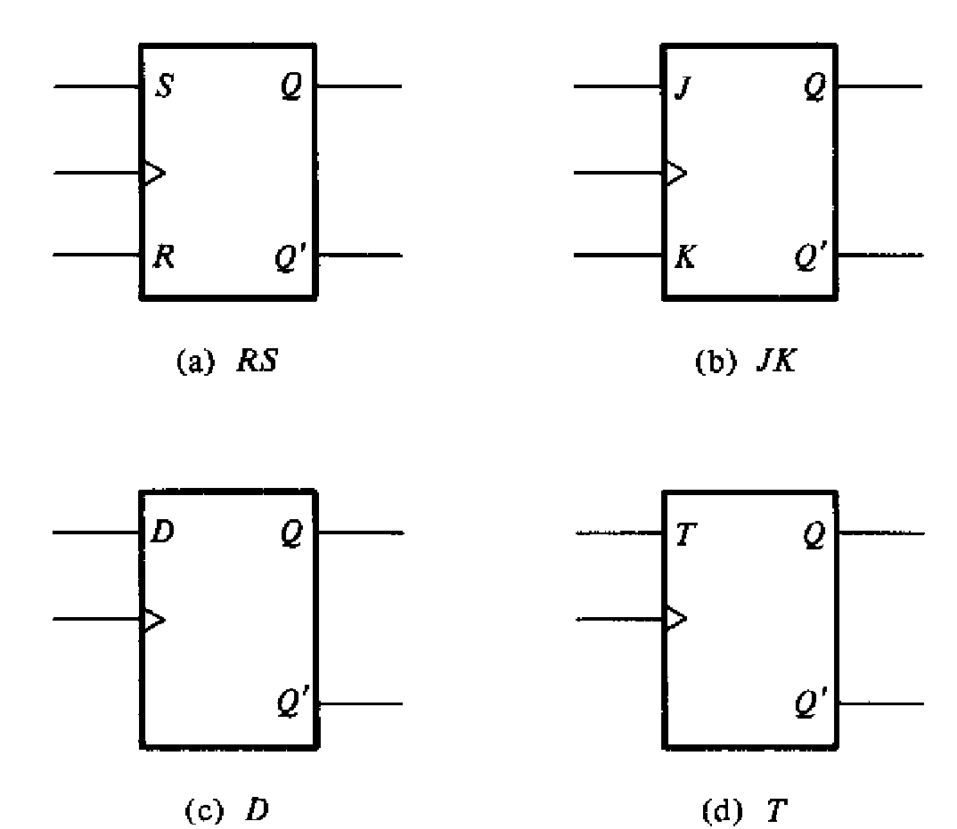
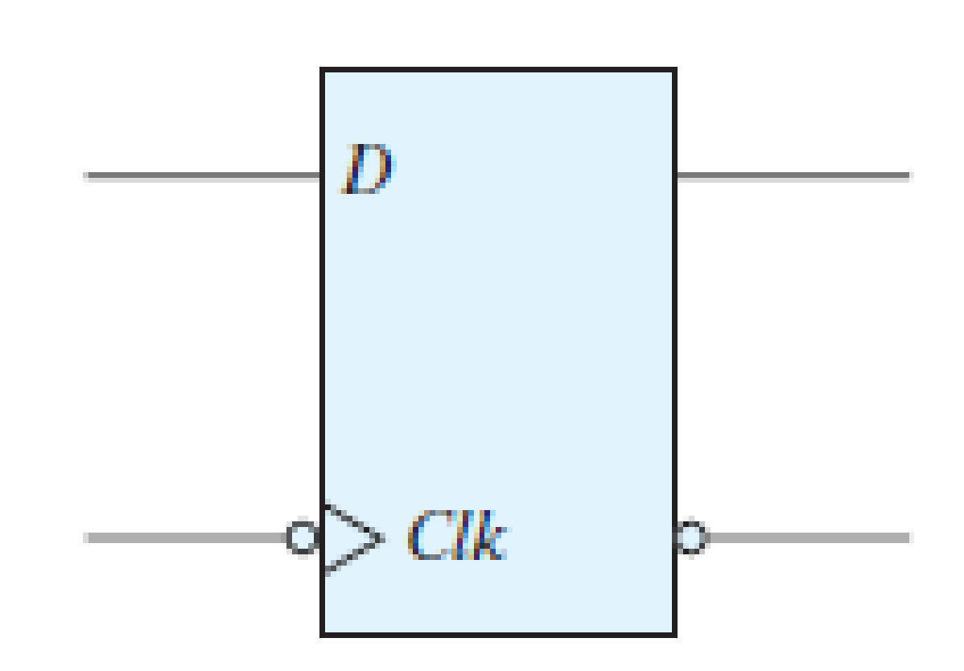
Graphic Symbols
Negative edge triggered D FF
Positive edge triggered FFs

